Slide 1
The average number of block interchanges needed to sort a permutation and a recent result of Stanley
Miklos Bona, Ryan Flynn
Information Processing Letters 109 (2009) 927–931
Presenter: Kai-Yu, Chen
Date: Oct. 28, 2009

Slide 2
Abstract
We use an interesting recent result of probabilistic flavor concerning the product of two permutations consisting of one cycle each to find an explicit formula for the average number of block interchanges needed to sort a permutation of length n.

Slide 3
Introduction（1/4）
Let p = p₁p₂ . . . p_{n} be a permutation. A block interchange is an operation that interchanges two blocks of consecutive entries without changing the order of entries within each block.
p= 3417562
p’= 5621734

Slide 4
Introduction（2/4）
Definition 1. The cycle graph G(p) of the permutation p =p₁p₂ . . . p_{n} is a directed graph on vertex set {0, 1, . . . ,n} and 2n edges that are colored either black or gray as follows.Set p₀ = 0.
(1) For 0≦i ≦ n, there is a black edge from p_{i} to p_{i−1,}where the indices are to be read modulo n +1, and
(2) For 0 ≦ i ≦ n, there is a gray edge from i to i + 1,where the indices are to be read modulo n +1.
G(p) has a unique decomposition into edge-disjoint directed cycles in which the colors of the edges alternate.
c(G(p)) be the number of directed cycles in this decomposition of G(p).
permutations of length n will be called n-permutations

Slide 5
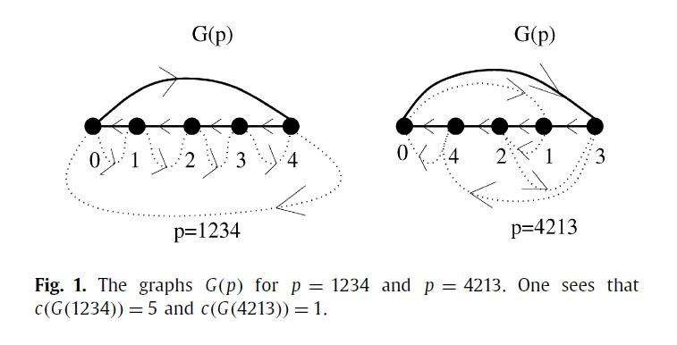
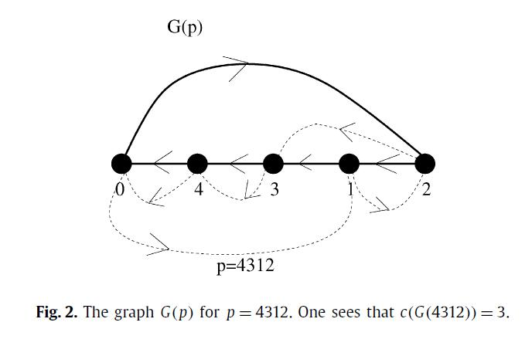

Slide 6
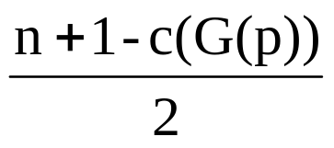
Introduction（3/4）
Theorem 1. The number of block interchanges needed to sort the n-permutation p is
Definition 2. The Hultman number S_{H}(n,k) is the number of n-permutations p satisfying c(G(p)) =k.
S_{n} denote the symmetric group of degree n.

Slide 7
Introduction（4/4）
Theorem 2. The Hultman number S_{H}(n,k) is equal to the number of ways to obtain the cycle (12 . . .n(n + 1)) ∈ S_{n+1} as a product qr of permutations, where q ∈ S_{n+1} is any cycle of length n + 1, and the permutation r ∈ S_{n+1} has exactly k cycles, that is c(Γ (r)) =k.

Slide 8
Main result（1/6）
Corollary 1. The Hultman number S_{H}(n,k) is equal to the number of (n + 1)-cycles q so that the product (12 . . .n(n + 1))q is a permutation with exactly k cycles, that is, c(Γ ((12 . . .n(n +1))q) =k.
In other words ,finding the average of the numbers c(G(p)) over all n-permutations p is equivalent to finding the average of the numbers c(Γ ((12 . . .n(n + 1))q), where q is an (n +1)-cycle.

Slide 9
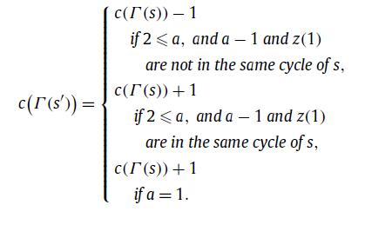
Main result（2/6）
Let us consider the product s = (12 . . .n)z, where z is a cycle of length n. Let us insert the entry n+1 into z to get the permutation z so that n + 1 is inserted between two specific entries a and b in the following sense.
Proposition 1. Let a, b, and z’ be defined as above, and let s’ =(12 . . . (n +1))z’. Then we have

Slide 10
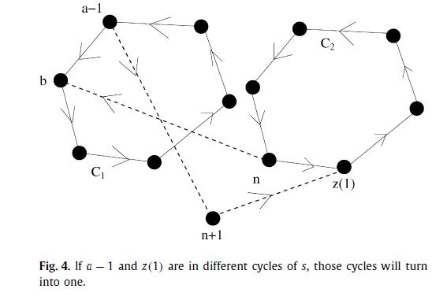
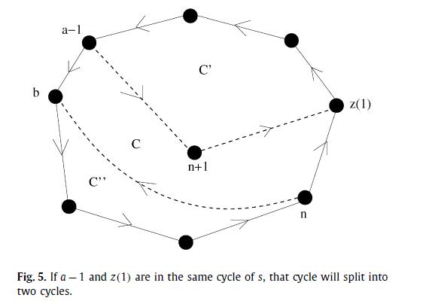

Slide 11
Main result（3/6）
The question is, how many times will an increase and how many times will a decrease occur.
In light of Proposition 1, this is the same question as asking how often the entries z(1) and a −1 are in the same cycle of s.
Furthermore, since z is just an arbitrary n-cycle, and a − 1 is an arbitrary element of a fixed n-cycle, this is equivalent to the following question.

Slide 12
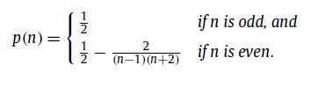
Main result（4/6）
Question 1. Let i and j be two fixed elements of the set [n] = {1, 2, . . . ,n}. Select an element (x, y) of TC_{n} at random. What is the probability that the product xy contains i and j in the same cycle?
TC_{n} denote the set of ordered pairs (x, y) of n-permutations that consist of one n-cycle each.
Theorem 3. Let i and j be two fixed, distinct elements of the set [n], where n > 1. Let (x, y) be a randomly selected element of TC_{n}. Let p(n) be the probability that i and j are in the same cycle of xy. Then

Slide 13
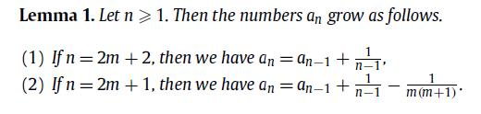
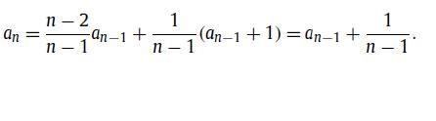
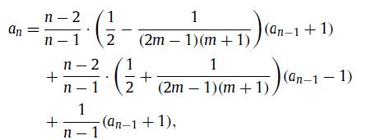
Main result（5/6）
Proof:
Apply Proposition 1
（1）
（2）
a_{n}:average number of cycles of xy

Slide 14
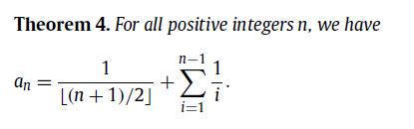
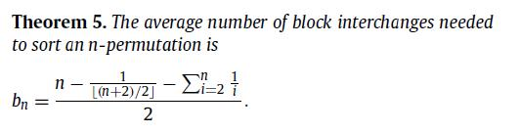
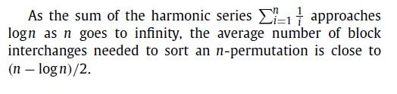
Main result（6/6）

Slide 15
Remarks and further directions
Richard Stanley’s proof of Theorem 3 is not elementary. A more combinatorial proof of the stunningly simple answer for the case of odd n would still be interesting.
there is an alternative way to obtain the result of Theorem 4 without using Theorem 3.

